Slide 1
Positive Definite Sliced Wasserstein Graph Kernel for Brain Disease Diagnosis
(MICCAI 2023)

Slide 2
Scientific Motivation
Why Mathematics for Brain Disease Analysis?
Brain disorders (ADHD, ASD, EMCI):
Alter functional connectivity patterns
Affect global information flow
Cannot be fully characterized by local graph statistics
Key Question:
How can we mathematically quantify structural dissimilarity
between two brain networks?
Desired properties of the solution:
Metric-based
Geometry-aware
Statistically meaningful
Computationally tractable

Slide 3
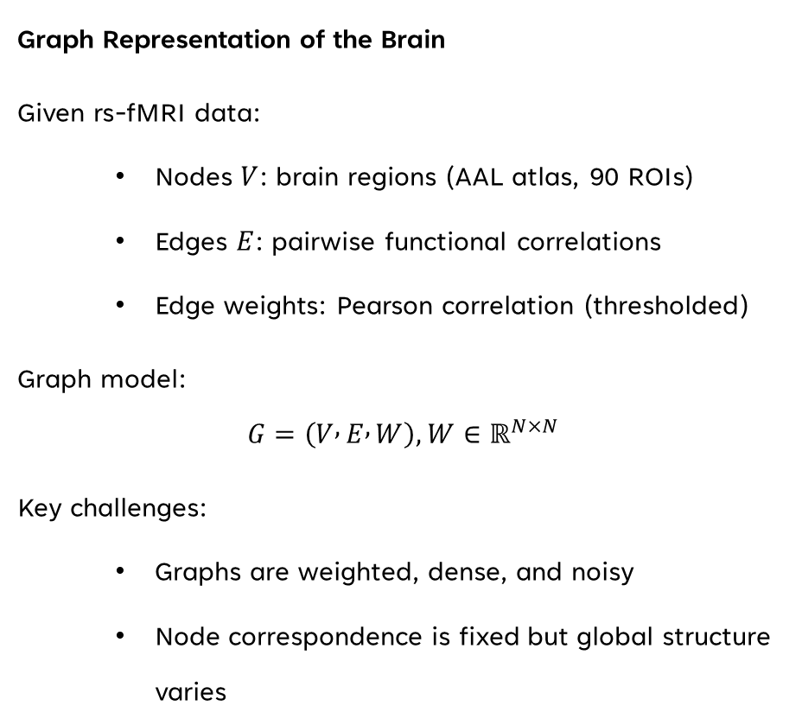
Brain Functional Networks as Graphs
Graph Representation of the Brain
Given rs-fMRI data:
Nodes $V$: brain regions (AAL atlas, 90 ROIs)
Edges $E$: pairwise functional correlations
Edge weights: Pearson correlation (thresholded)
Graph model:
$$G=\left(V , E , W\right), W∈ℝ^{N×N}$$
Key challenges:
Graphs are weighted, dense, and noisy
Node correspondence is fixed but global structure varies

Slide 4
Limitations of Classical Graph Features
Why Standard Network Measures Are Insufficient
Traditional approaches rely on:
Degree distribution
Clustering coefficient
Local efficiency
Betweenness centrality
Limitations:
Mostly local descriptors
Ignore global geometry
No notion of transport or flow
Poor discriminative power for subtle diseases
Conclusion:
We need geometry-aware distances between graphs.

Slide 5

From Graph Comparison to Geometry
Reformulating the Problem
Instead of comparing:
$$\text{Graph} \text{statistics}$$
We compare:
$$\text{Geometric} \text{distributions} \text{derived} \text{from} \text{graphs}$$
Strategy:
Embed graph into Euclidean space
Represent nodes as a point cloud
View the point cloud as a probability measure
Measure distance using Optimal Transport

Slide 6
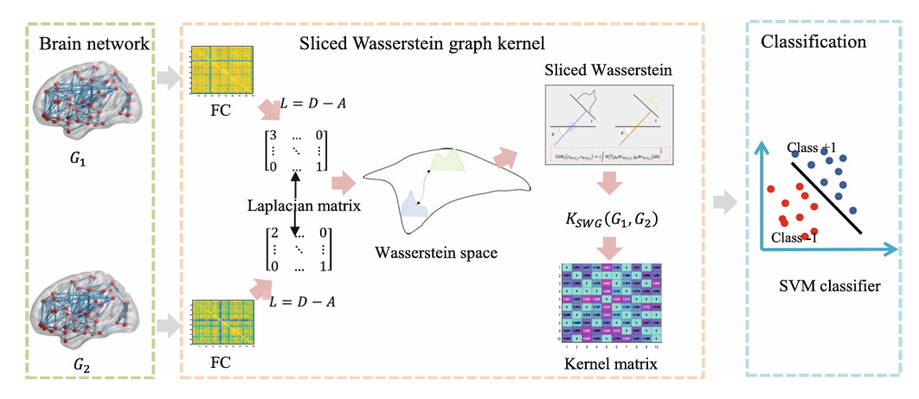
Framework Overview
Proposed Pipeline
Steps:
Functional connectivity → weighted graph
Laplacian spectral embedding
Probability measure construction
Graph Sliced Wasserstein distance
Exponential kernelization
SVM-based classification
This pipeline bridges:
Graph Theory → Geometry → Optimization → Learning

Slide 7
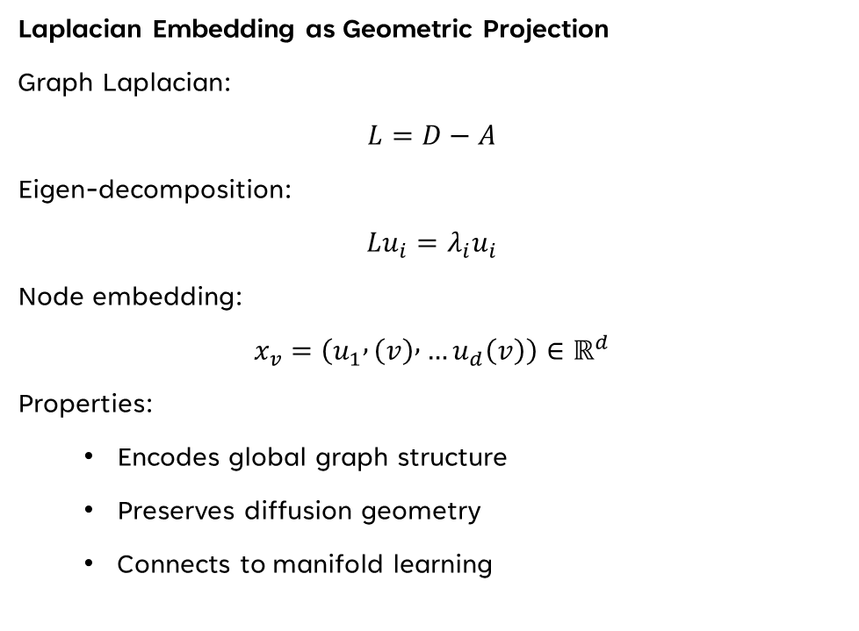
Spectral Graph Embedding
Laplacian Embedding as Geometric Projection
Graph Laplacian:
$$L=D−A$$
Eigen-decomposition:
$$Lu_{i}=λ_{i}u_{i}$$
Node embedding:
$$x_{v}=\left(u_{1} , \left(v\right) , …u_{d}\left(v\right)\right)∈ℝ^{d}$$
Properties:
Encodes global graph structure
Preserves diffusion geometry
Connects to manifold learning

Slide 8

From Embedded Nodes to Probability Measures
Graph as a Distribution
After embedding:
$$X_{G}=\left\{x_{1} , … , x_{N}\right\}⊂ℝ^{d}$$
Define empirical measure:
$$r_{Φ\left(G\right)}=\frac{1}{N}\sum_{i=1}^{N}{δ_{x_{i}}}$$
Interpretation:
A brain graph becomes a distribution of mass
in a latent geometric space.

Slide 9

Optimal Transport Perspective
Wasserstein Distance
For two measures $r$, $c$:
$$W_{p}\left(r , c\right)={\left(\underset{γ∈Γ\left(r , c\right)}{\inf{}}\int{∥}x−y∥^{p}dγ\left(x , y\right)\right)}^{1/p}$$
Meaning:
Minimum cost to transform one distribution into another
Cost reflects global structural change
Challenge:
High-dimensional OT is computationally expensive

Slide 10
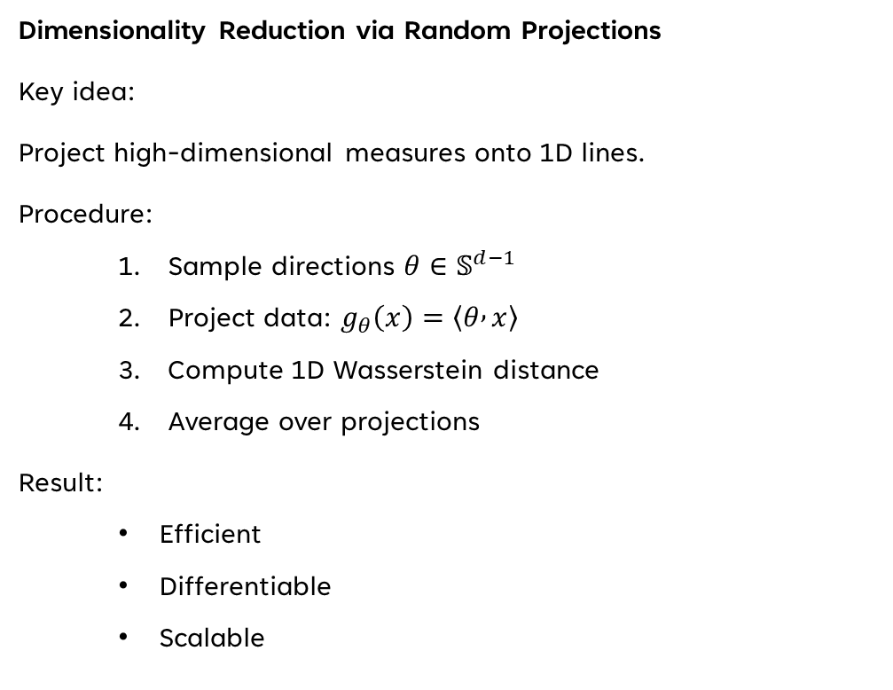
Sliced Wasserstein Distance
Dimensionality Reduction via Random Projections
Key idea:
Project high-dimensional measures onto 1D lines.
Procedure:
Sample directions $θ∈𝕊^{d−1}$
Project data: $g_{θ}\left(x\right)=\left\langle θ , x\right\rangle$
Compute 1D Wasserstein distance
Average over projections
Result:
Efficient
Differentiable
Scalable

Slide 11
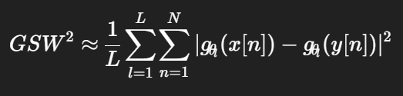

Graph Sliced Wasserstein Distance (GSW)
Extending SW to Graphs
Definition:
$$D_{GSW}^{Φ}\left(G_{1} , G_{2}\right)=GSW_{2}\left(r_{Φ\left(G_{1}\right)} , c_{Φ\left(G_{2}\right)}\right)$$
Approximation:
Key aspects:
Sorting-based computation
Avoids full OT optimization

Slide 12
Metric Properties
Theoretical Guarantees
Theorem:
Graph Sliced Wasserstein Distance is a valid metric.
Properties:
Non-negativity
Symmetry
Identity of indiscernibles
Triangle inequality
This ensures:
Meaningful geometry
Stable learning behavior

Slide 13

From Distance to Kernel
Sliced Wasserstein Graph Kernel
Definition:
$$K_{SWG}\left(G_{1} , G_{2}\right)=exp⁡\left(−λD_{GSW}^{Φ}\left(G_{1} , G_{2}\right)\right)$$
Why kernelization?
Enables non-linear classification
Allows SVM optimization
Embeds graphs into RKHS

Slide 14
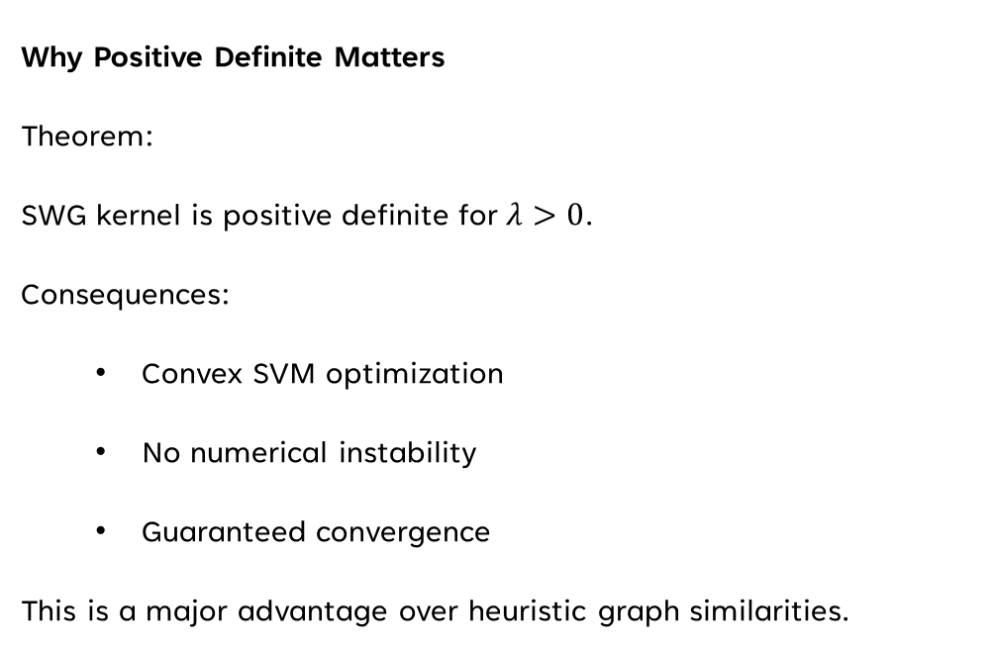
Positive Definiteness
Why Positive Definite Matters
Theorem:
SWG kernel is positive definite for $λ>0$.
Consequences:
Convex SVM optimization
No numerical instability
Guaranteed convergence
This is a major advantage over heuristic graph similarities.

Slide 15
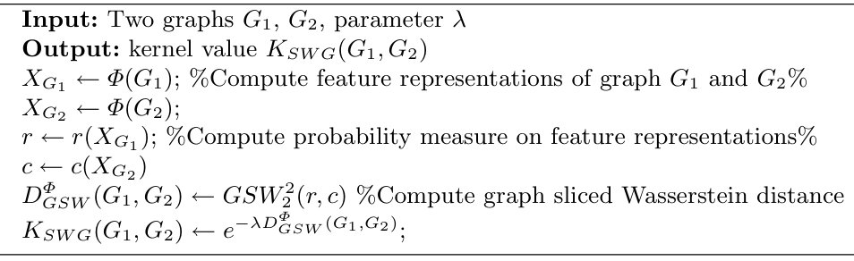
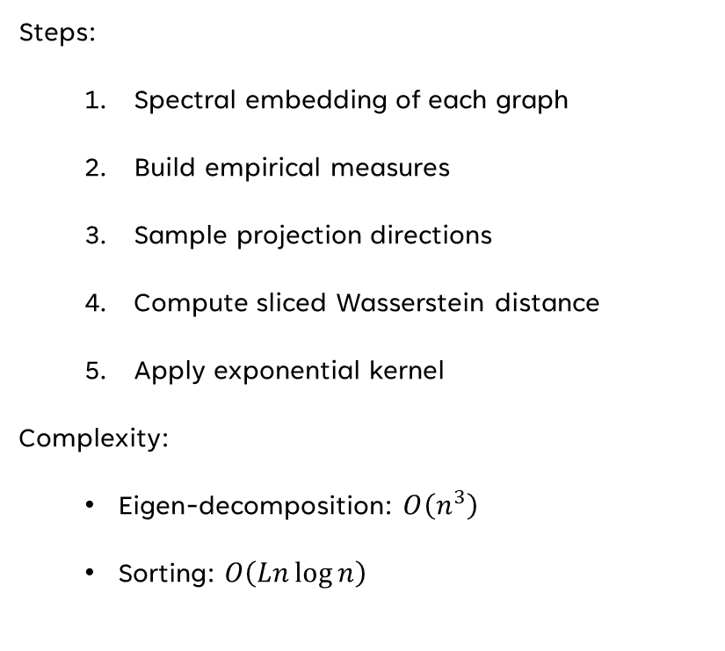
Algorithmic Implementation
Algorithm: Computing SWG Kernel
Steps:
Spectral embedding of each graph
Build empirical measures
Sample projection directions
Compute sliced Wasserstein distance
Apply exponential kernel
Complexity:
Eigen-decomposition: $O\left(n^{3}\right)$
Sorting: $O\left(Ln\log{n}\right)$

Slide 16
Datasets and Experimental Setup
Brain Disease Benchmarks
Datasets:
ADHD vs NC
ASD vs NC
EMCI vs NC
Settings:
10-fold cross-validation
SVM classifier
Accuracy & AUC metrics
Ensures fair and robust evaluation.

Slide 17
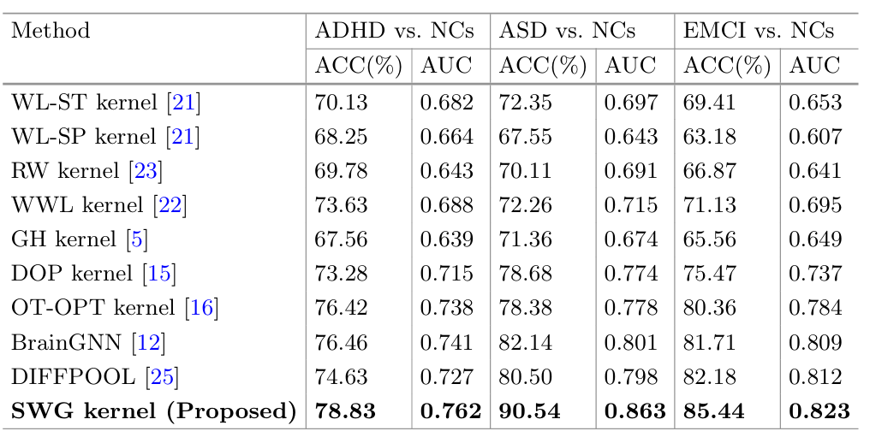
Classification Performance
Quantitative Results
Observations:
SWG achieves highest accuracy across all tasks
Particularly strong for ASD (90.54%)
Outperforms both kernels and GNNs
Indicates strong geometric discriminability.

Slide 18
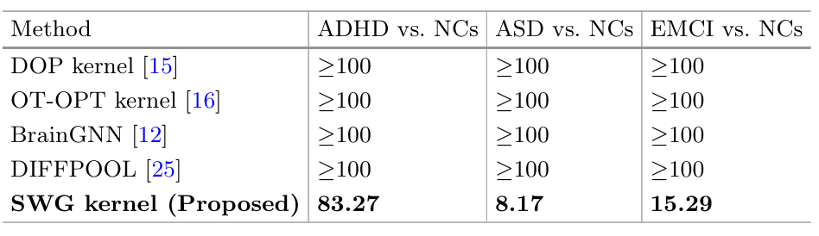
Computational Efficiency
Runtime Comparison
Key result:
GNN-based methods: ≥ 100s
SWG: order-of-magnitude faster
Reason:
Avoids backpropagation
Uses closed-form OT approximations

Slide 19
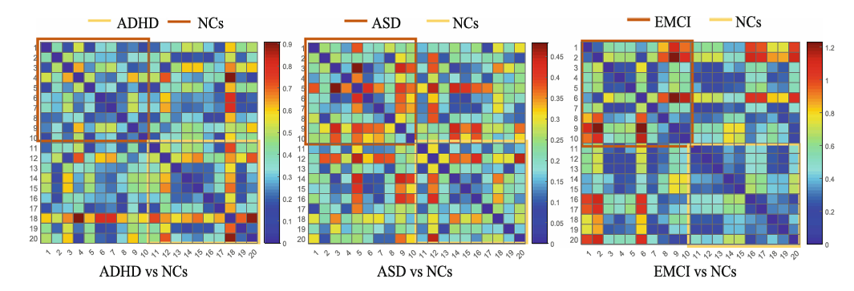
Interpretation of Distance Heatmaps
Geometric Meaning of Results
Observation:
Patients show larger Wasserstein distances
Indicates higher transport cost
Interpretation:
Disease alters the global geometry
of functional brain networks

Slide 20
Future Directions & Mathematical Impact
Beyond This Work
Potential extensions:
Learnable slicing directions
End-to-end SW loss in GNNs
OT-based pooling layers
Multi-scale Wasserstein kernels
Final message:
This work demonstrates how
Optimal Transport + Geometry + Kernels
form a powerful paradigm in Data Science.

Slide 21
Thank you
Hannah Fathi
hannahfathi99@gmail.com

